Slide 1



Investigating Max Pressure Jump in Mixed Phase
Katta Naveen
Supervisor : Dr .Ritam Mallick
Department of Physics

Slide 2
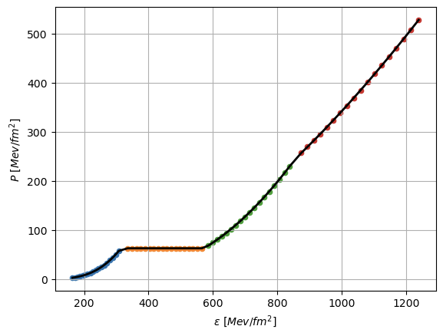
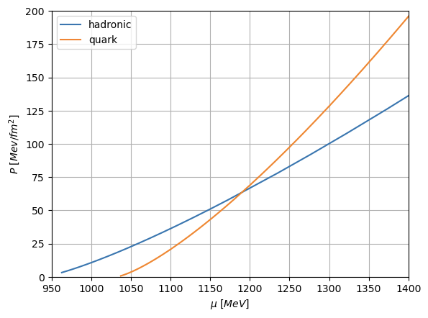

Introduction
In neutron stars, extreme high-density and low-temprature conditions—unachievable on Earth—allow us to study phase transitions at those conditions.
We investigate the phase transition between hadronic to quark matter in neutron stars by using a quadratic interpolation method.
By implementing a piecewise polytropic equation of state (EOS) for the hadronic and quark phases, we create a smooth transition across the mixed phase.
We are trying to learn how the smoothness of the transition behaves if we keep on changing the EoS.
And finally for a any given EoS can we determine the maximum smoothness of the mixed phase.
We construct EoS using piecewise polytrope.
The EoS is divided into three polytropes for having hadronic, mixed and quark phase.

Slide 3
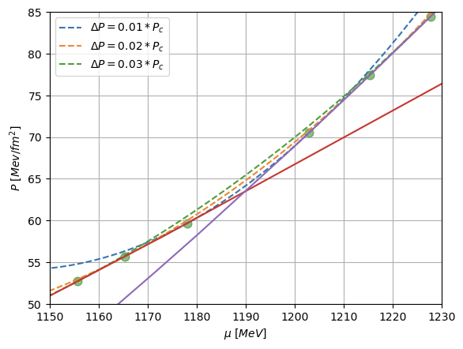
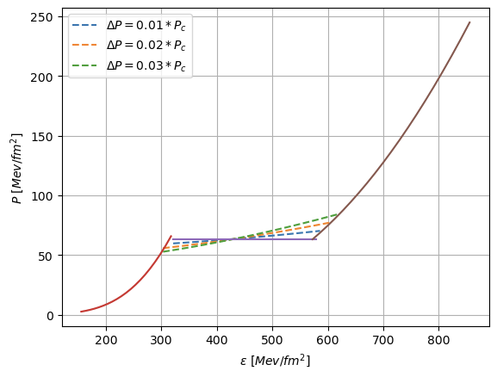
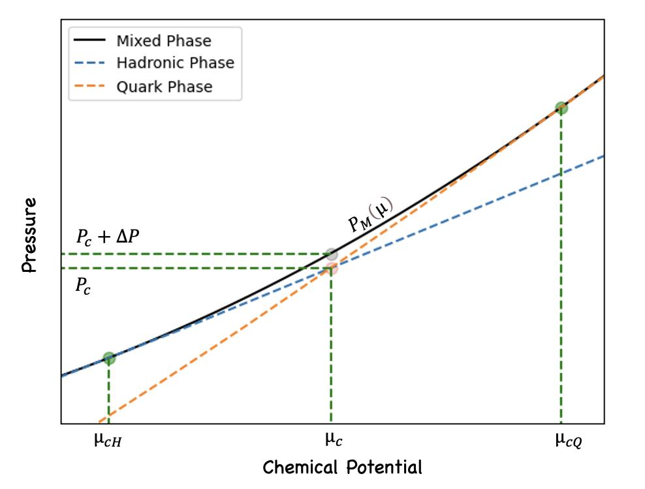
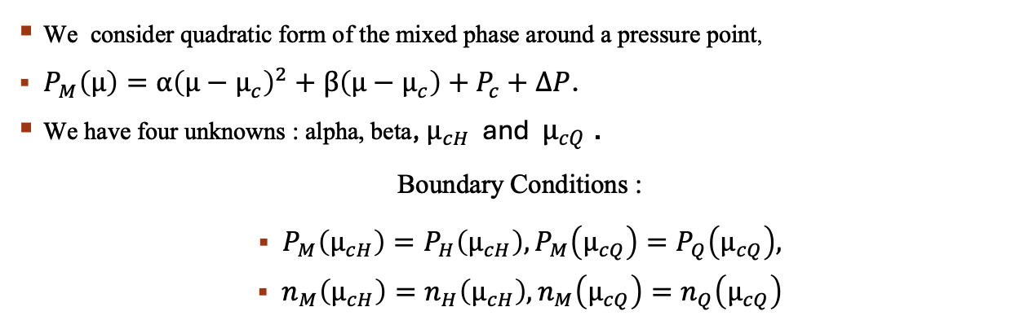
Quadratic interpolation
We consider quadratic form of the mixed phase around a pressure point,
$P_{M}\left(μ\right)=α{\left(μ−μ_{c}\right)}^{2}+β\left(μ−μ_{c}\right)+P_{c}+ΔP$.
We have four unknowns : alpha, beta, $μ_{cH}$ and $μ_{cQ}$ .
Boundary Conditions :
$P_{M}\left(μ_{cH}\right)=P_{H}\left(μ_{cH}\right),P_{M}\left(μ_{cQ}\right)=P_{Q}\left(μ_{cQ}\right),$
$n_{M}\left(μ_{cH}\right)=n_{H}\left(μ_{cH}\right),n_{M}\left(μ_{cQ}\right)=n_{Q}\left(μ_{cQ}\right)$

Slide 4
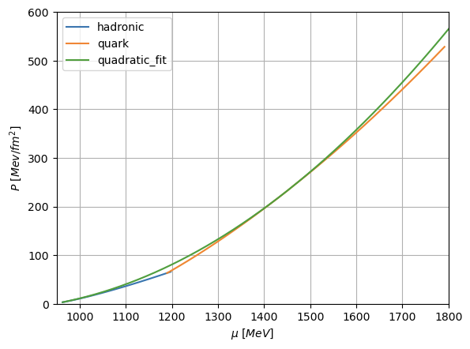
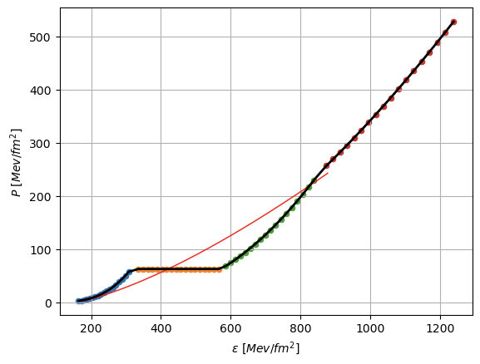

MAXIMUM INTERPOLATION ACHIEVABLE
Now we will keep the $μ_{cH}$ to initial chemical potential of hadronic phase.
We develop a model such that it finds the optimal values of alpha and beta for such EoS.
DEFINE QUADRATIC FUNCTION
EQUALITY CONSTRAINT
INEQUALITY CONSTRAINT
OPTIMIZATION
OUTPUT

Slide 5
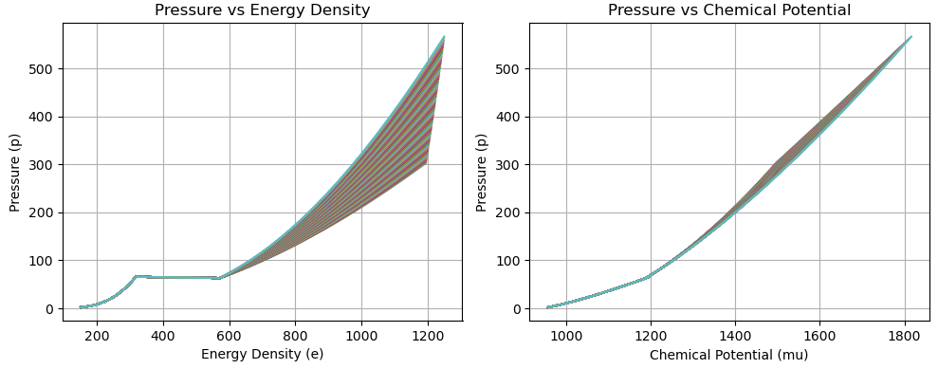
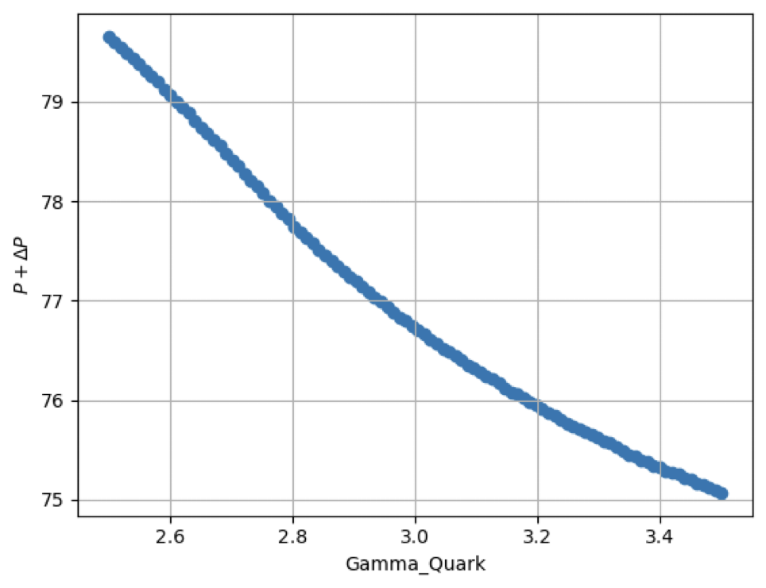
Impact of Different Polytropic Index
If we change the Gamma value of Quark, Polytrope changes so does the EoS, Gamma Quark is ranging from 2.5 to 3.5 .
Now if we find the maximum interpolation for these different EoS, we get the respective additional pressure terms.
In the figure we can see that if we keep on increasing the polytrope index of quark the additional pressure term will keep on decreasing following a trendline.
Future Work
We want to change the transition point i.e, Pressure and Chemical Potential at critical point, where the transition happens, and observe how the additional pressure changes with respect to these EoS.
Also match these results with the observational results of Neutron Stars.

Slide 6

References
[1] V. Abgaryan, D. Alvarez-Castillo, A. Ayriyan,D. Blaschke, and H. Grigorian, Universe 4, 94 (2018).
[2] A. Ayriyan and H. Grigorian, EPJ Web of Conferences173, 03003 (2018).
[3] F. Weber, M. Orsaria, H. Rodrigues, and S.-H. Yang,Proceedings of the International Astronomical Union 8,61–66 (2012).
[4] G. Watanabe and T. Maruyama, Nuclear pasta in
supernovae and neutron stars (2012), arXiv:1109.3511
[nucl-th].
[5] Z. F. Seidov, Soviet Astronomy 15, 347 (1971).
[6] D. E. Alvarez-Castillo and D. B. Blaschke, Physical
Review C 96, 10.1103/physrevc.96.045809 (2017).
[7] S. . Contributors, Nature Methods 17, 261 (2020).

Slide 7
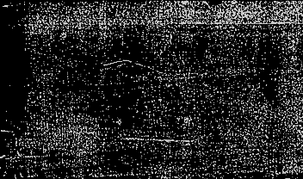
Thank you
Department of Physics

